Slide 1
Module 03 : Post-installation Configuration and Personalization

Slide 2
Module agenda
Configure and Customize the Windows Start Menu
Common Configuration Options
Windows PowerShell

Slide 3
Lesson 1: Configure and Customize the Windows Start Menu

Slide 4
Lesson 1: Configure and Customize the Windows Start Menu
Customizing the User Interface
Action Center
Configure Cortana

Slide 5
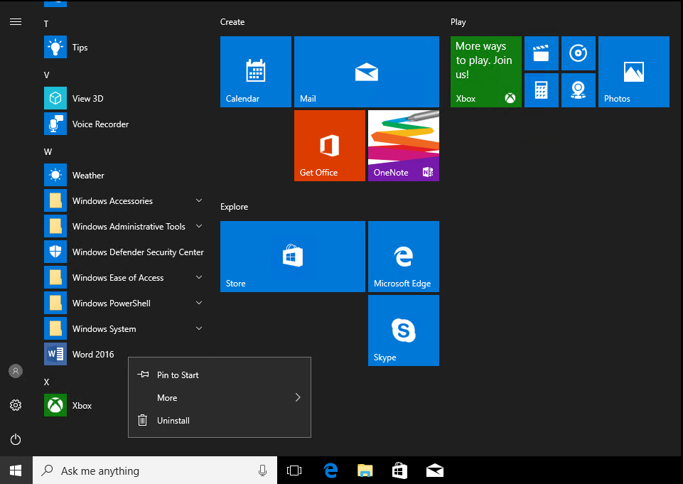
Customizing the user interface
You can perform the following customizations from the Start screen:
Manage tiles:
Add tiles
Remove tiles
Pin items to taskbar
Resize tiles:
Configure live tiles
Group tiles
Notes:
Note: This topic has three additional slides. Consider using this topic’s content as a basis for presenting the following demonstration.
This first slide shows a text summary of the three graphical slides that follow.
20697-1D
1: Overview of Windows 10

Slide 6
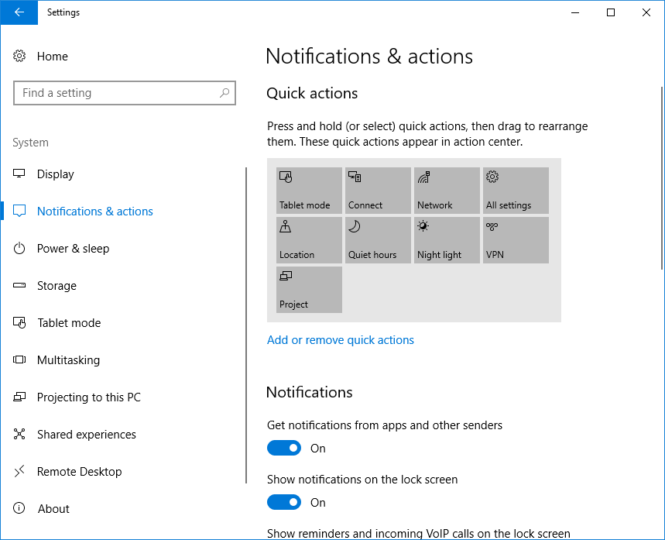
Action Center
Notes:
Consider demonstrating these settings.
20698B
2: Performing post-installation configuration

Slide 7
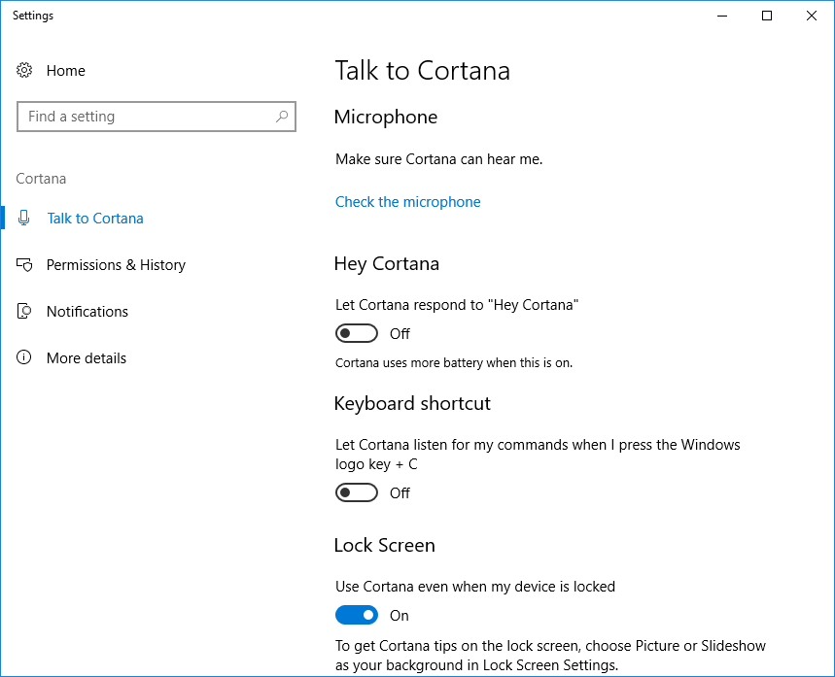
Configure Cortana
Notes:
Consider demonstrating these settings.
20698B
2: Performing post-installation configuration

Slide 8
Lesson 2: Common Configuration Options

Slide 9
Lesson 2: Common Configuration Options
Display Options
Options for Mobile Devices
Power Plans
Windows 10 Privacy
Using the Settings App
Using Control Panel

Slide 10
Display options
Found in Settings app:
Display item in the System category
Can detect and configure multiple displays
Can configure text size, resolution
Can adjust orientation on tablets:
Portrait or Landscape
Notes:
Many of the display settings are not available from a virtual machine. If you have a device or laptop that can plug into another monitor or the projector, you might want to demonstrate these settings. A demonstration of all the various settings follows this topic, so you may wish to have the students follow along this topic page while you perform the demonstration.
20697-1D
3: Configuring Your Device

Slide 11
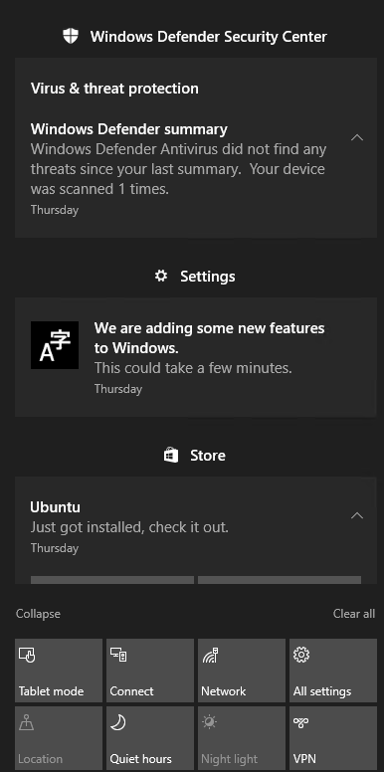
Options for mobile devices
Includes:
Laptops & notebooks
Tablets
Windows 10 Mobile
Tablets
Settings app:
Display, Power, Tablet mode
Action Center:
Quick Actions
Notes:
Explain that a large majority number of devices are mobile, and Windows 10 accommodates them specifically, through various options that you can configure in the Settings app and by using the Quick Actions tiles in the Action Center.
20697-1D
3: Configuring Your Device

Slide 12
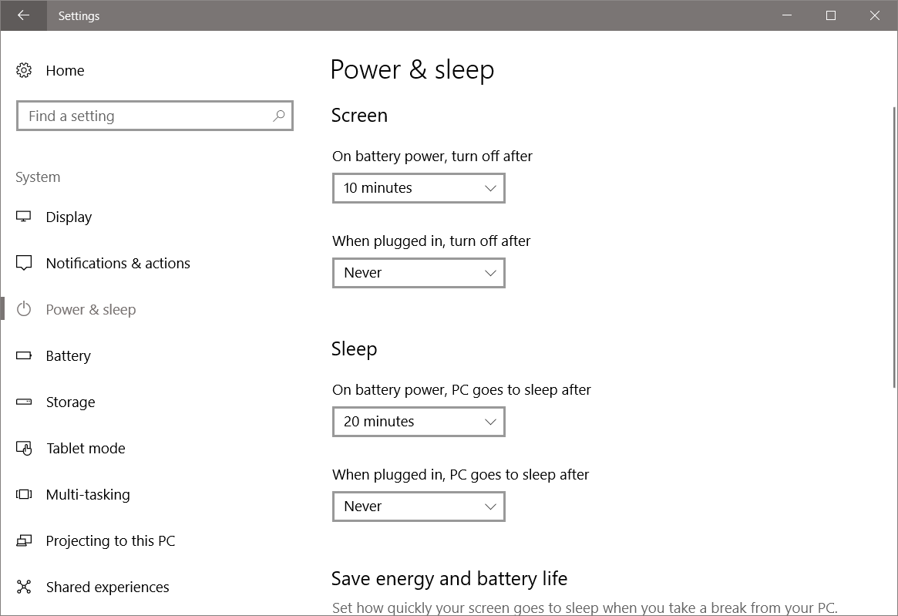
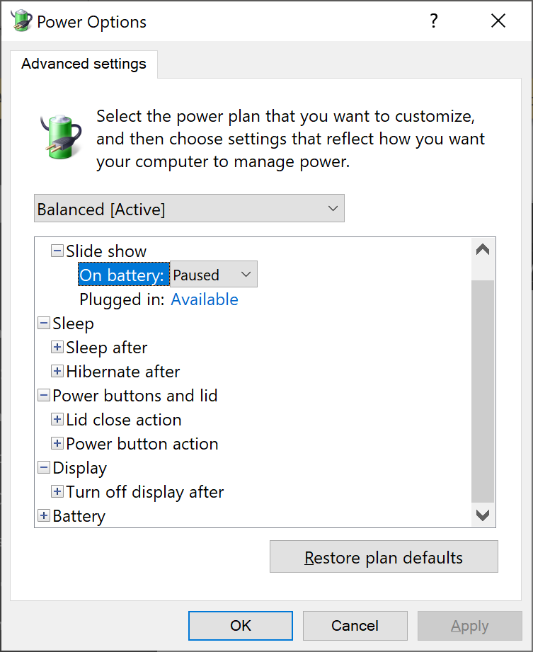
Power Plans
Notes:
Consider demonstrating these settings.
20698B
2: Performing post-installation configuration

Slide 13
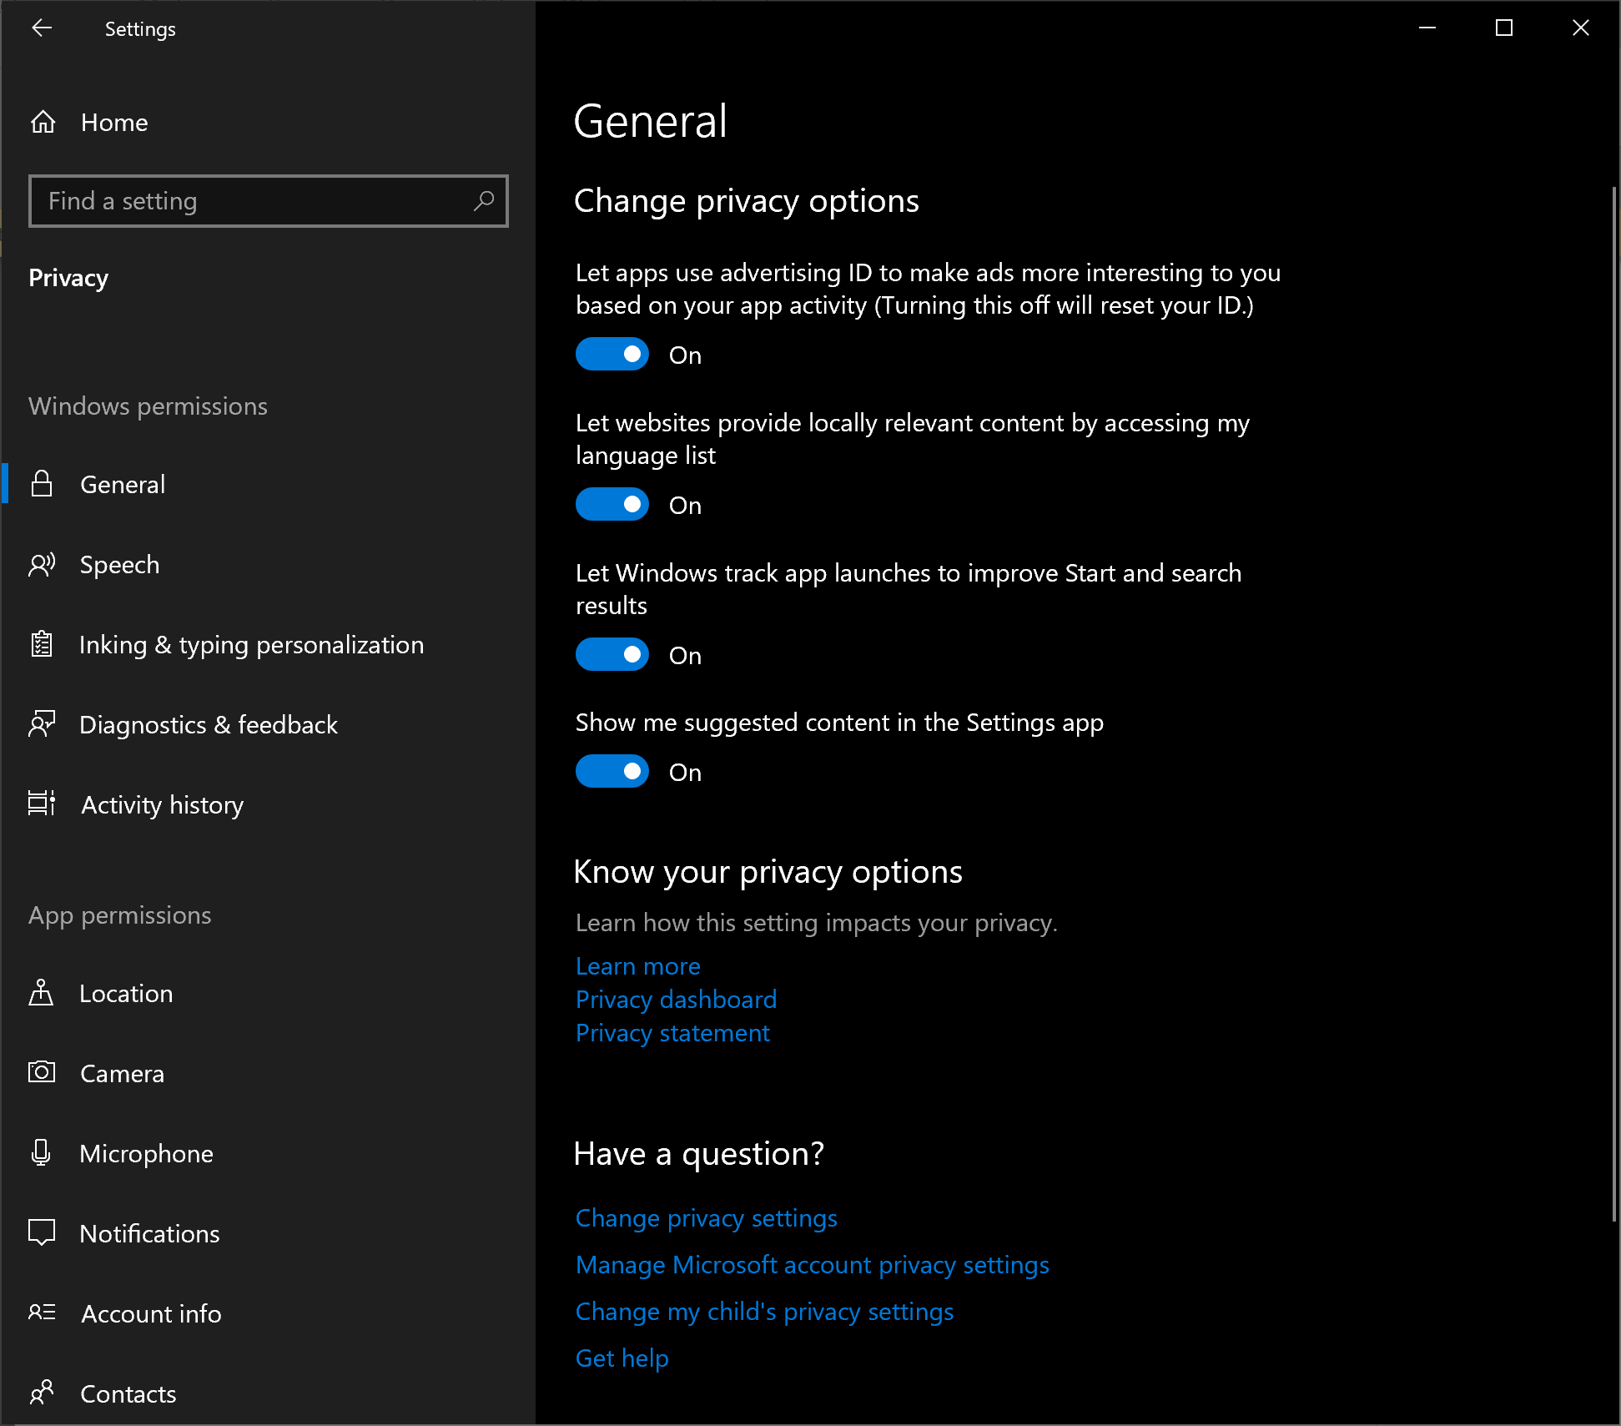
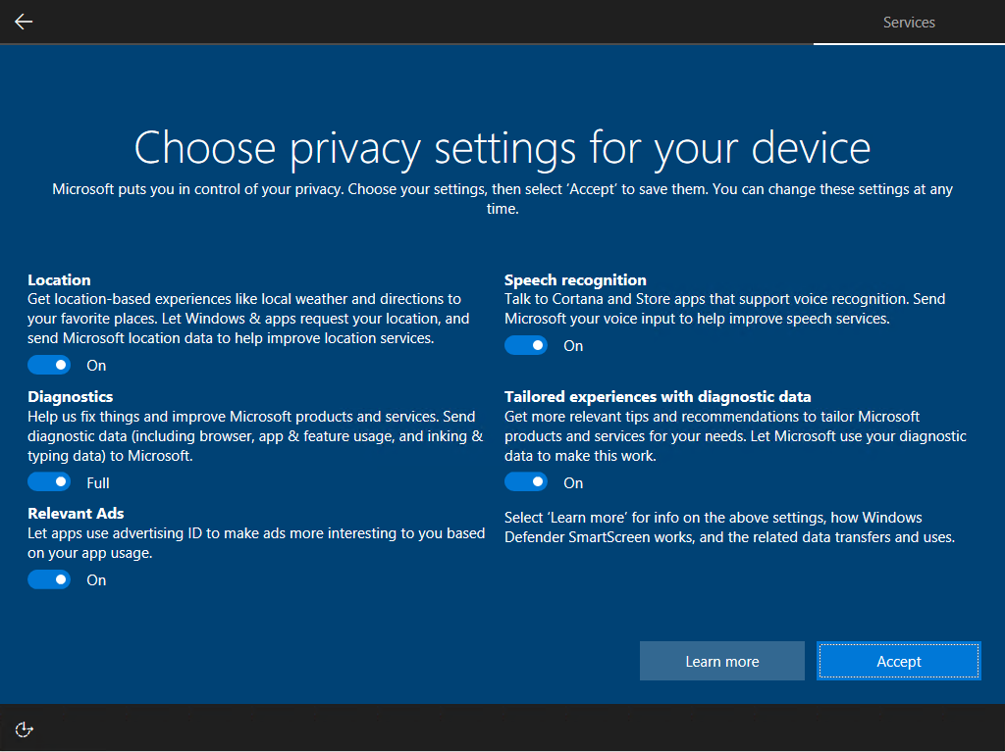
Windows 10 Privacy
Notes:
Consider demonstrating these settings.
20698B
2: Performing post-installation configuration

Slide 14
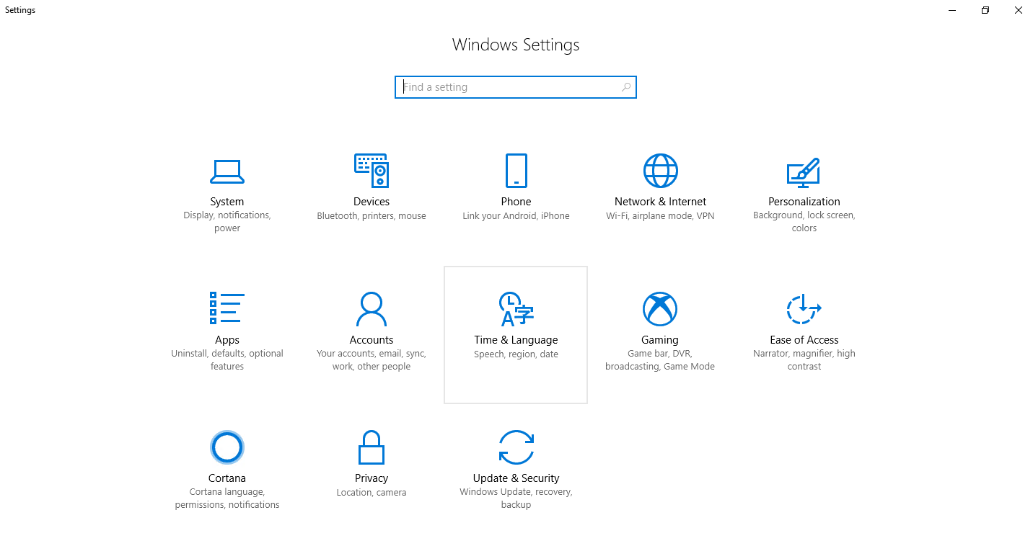
The Settings app
Notes:
There are several changes in the Settings app since Windows 8.1. There are thirteen major categories, each containing many subcategories. You can discuss some of these with the class. You may wish to demonstrate the different ways that you can open the Settings app.
20697-1D
3: Configuring Your Device

Slide 15
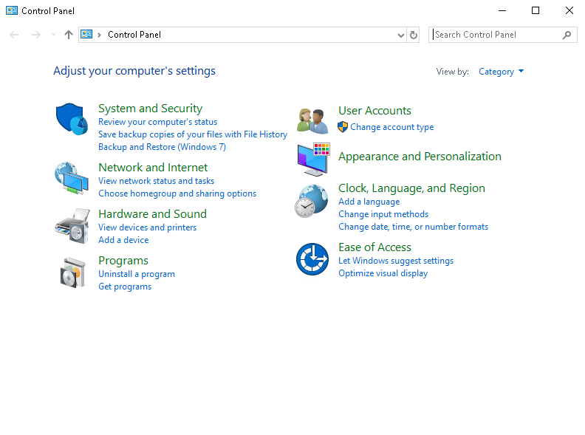
Using the Control Panel
Notes:
Explain that the settings for new features are primarily found in the Settings app. But some settings can only be fully managed in the Control Panel. For some features, the settings in the Settings app are different from those in Control Panel. An example is the settings for configuring File History. That will be covered in Module 11, “Troubleshooting and recovery.”
20697-1D
3: Configuring Your Device

Slide 16
Lesson 3: Windows PowerShell

Slide 17
Lesson 3: Windows PowerShell
What Is Windows PowerShell?
Using Windows PowerShell
Remote Commands in Windows PowerShell
Notes:
In this lesson, you will cover the four major tools that you can use to configure a Windows 10 device: the Settings app, Control Panel, Windows PowerShell, and GPOs. The Settings app is new, so expect to spend time covering this in detail.
20697-1D
3: Configuring Your Device

Slide 18
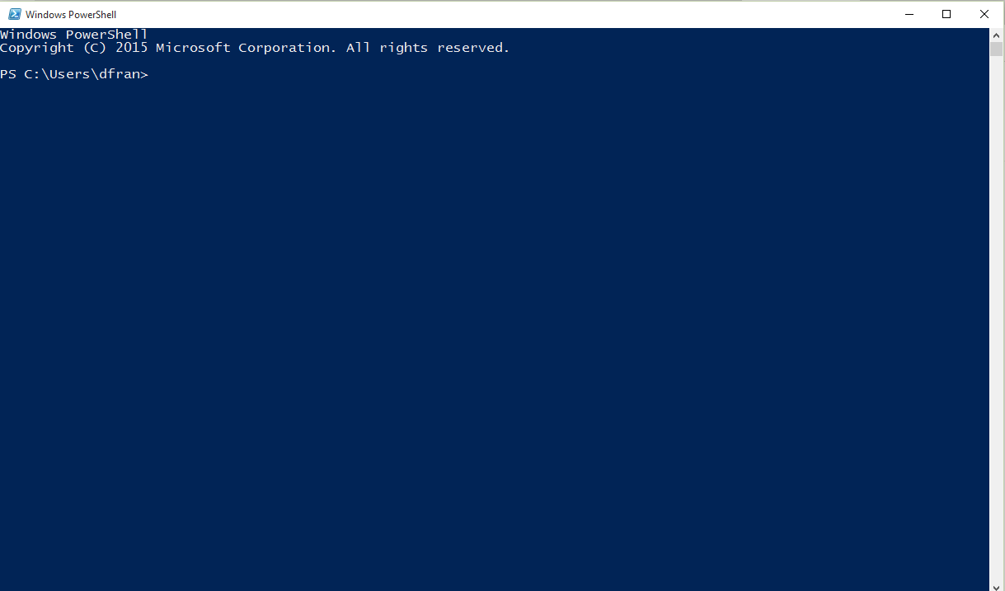
What is Windows PowerShell?
Windows PowerShell is an administrative tool that provides:
Operating-system integration
Remote management functionality
Script-based execution
Notes:
Introduce Windows PowerShell and its primary functions. Explain the three features that the slide lists, and describe how they make Windows PowerShell a powerful administrative tool. Explain how Windows PowerShell Integrated Scripting Environment (ISE) can help you write scripts, and find and use complex cmdlet parameters easily.
20697-1D
3: Configuring Your Device

Slide 19
Using Windows PowerShell
Windows PowerShell is a command-line shell designed for system administration
Windows PowerShell drives provide access to:
The file system
The registry
Variables in memory
Cmdlets:
Have a verb-noun format
May have parameters
Example:
You can use Windows PowerShell to efficiently perform bulk operations
Start-Service –Name “Application Identity”
Notes:
Many students with basic network administration skills are not comfortable with the idea of performing administration by using a command-line interface (CLI). Explain that the main benefit of using Windows PowerShell for administration is the ability to perform bulk operations with relatively simple commands and scripts.
Students might be concerned with how to find out about available cmdlets and how to use them. Explain the Get-Help and Get-Command cmdlets. Also, explain that an internet search can provide practical examples of how to use Windows PowerShell. Microsoft also provides the Microsoft Script Center, which you may want to open in the browser. You can then show some of the items in the Script Repository.
Reference
Microsoft Script Center
http://aka.ms/ipge1q
20697-1D
3: Configuring Your Device

Slide 20
Remote Commands in Windows PowerShell
Remoting features of Windows PowerShell are built on Windows Remote Management
Run an individual command or create a persistent connection or session to run a series of commands
To enable remoting, use the following procedure:
Verify the status of the Windows Remote Management service:
Winrm quickconfig
Enable remoting:
Enable-PSremoting -force
Notes:
Windows PowerShell remoting features are built on Windows Remote Management, the Microsoft implementation of the Web Services-Management (WS-Management) set of protocols. Windows Remote Management is a standard Simple Object Access Protocol (SOAP)–based, firewall-compatible communications protocol. It uses the WS-Management protocol with a special SOAP payload designed specifically for Windows PowerShell commands.
Make sure that students understand what a session is, which computer is the local computer, and which computer is the remote computer. When you use remoting, you can run individual commands or create a persistent connection (session) to run a series of related commands. You can start an interactive session with a remote computer so that the commands run directly on the remote computer. When you are working remotely, you type commands on one computer (the local computer), and the commands run on another computer (the remote computer).
Finally, discuss the three types of remoting that the slide includes:
One-to-one, or interactive remoting
One-to-many, or fan-out remoting
Many-to-one, or fan-in remoting
20698B
6: Implementing remote management

Slide 21
Practice Lab: Configuring Windows 10

